Slide 1
10 ms
1
2
3
4
97
98
99
1PPS
1PPS

Slide 2
10 ms
1
2
3
4
97
98
99
NCOM packets
NMEA String
1
2
3
4
97
98
99
1PPS
1PPS
NCOM packet time
500097.208 (seconds from midnight Sunday)
NMEA String time
500097.208 (seconds from midnight Sunday)

Slide 3
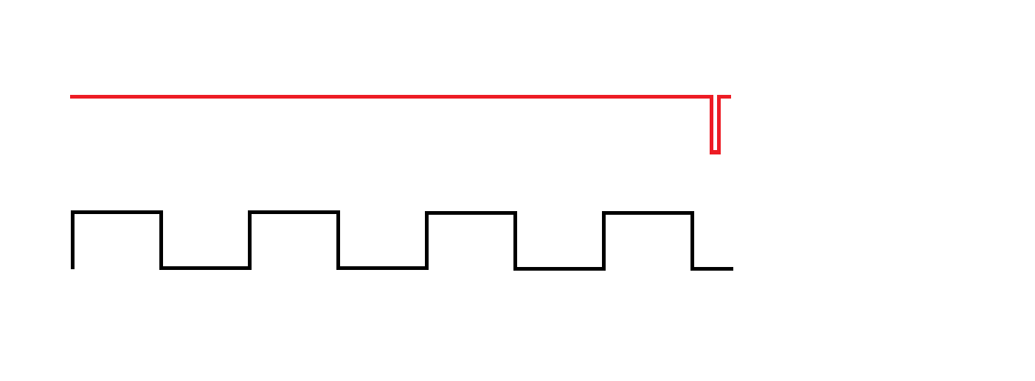
1 PPS
IMU SYNC
*Not to scale
1-5 µs
~

